Slide 1
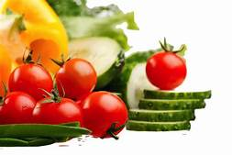
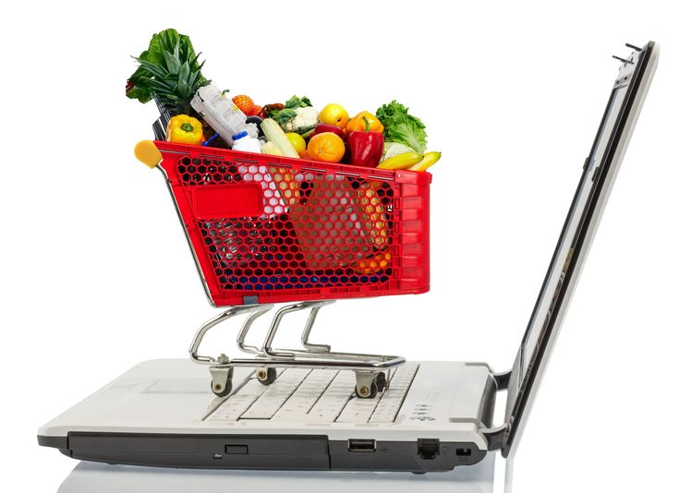
Online vegetables and Fruits Kart

Slide 2
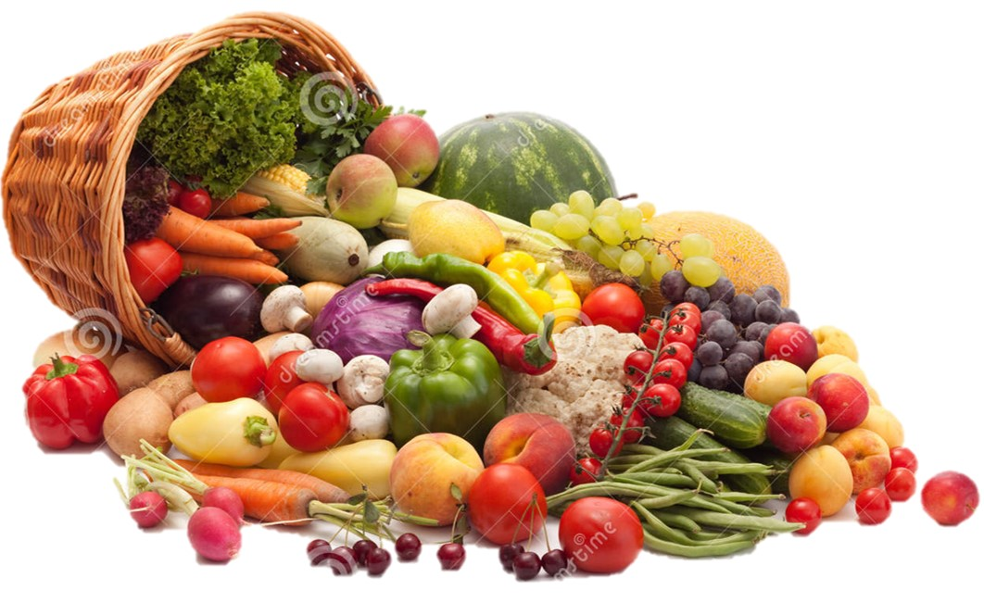
Introduction
A fruit is a seed bearing part of plant and is edible when ripen and fleshy. Many vegetables may be considered fruit in the true botanical sense. Botanically, fruits are those portion of plant which house seeds. Therefore, items such as tomatoes, cucumber, peppers etc. would be classified as fruit on this basis. However, important distinction between fruit and vegetable lies on usage basis. Those items that are generally eaten with main course of meal are considered vegetables. Those that are commonly eaten as deserts are considered fruits. Vegetables are derived from different parts of the plants.

Slide 3
Need
To help people to have easy access to their grocery shopping.
To help women save their time and concentrate on more productive things.
To involve men and youth too in buying grocery and share the load.

Slide 4

Idea
Idea is to provide grocery vegetables and fruits shopping convenient for the customer.
By making use of android apps and e-commerce sites, give women relaxation from bargaining with vegetable vendors.
This idea will work because we will be providing cash back facility.

Slide 5
Product/Service differentiator
Exclusive and fresh vegetables and fruits.
Assured high quality-chlorinated and washed fruits and vegetables.
Cash back facility.

Slide 6
Ability (TEAM)
Founder members for strategizing and decision making.
Sales & Marketing Head
Employees
Customer Service & Medical
Employees
Managing Director
Manager
Head of IT
Employees
Head of finance
Employees

Slide 7
Business Mode ( How to make money )
Charge customer with prices lower than in market.
Facility of cash on delivery and online payment.
Once our app will be downloaded it will flash on connected (incoming and outgoing)
Google Ad words is the source of revenue.

Slide 8


Marketing Strategies (How to get customers)
Radio marketing
Social media marketing
Pamphlets
Print advertising
Hoardings

Slide 9
Thank You

